Slide 1
Global Ozone and Surface UV Climatology Data Products for NASA Earth Observations (NEO) and Science on the Sphere (SOS)
Tropospheric Column Ozone in Dobson Units
Stratospheric Column Ozone in Dobson Units
Total Column Ozone in Dobson Units
Surface UV-Index
(These four data products represent 12-month climatologies with horizontal resolution of 1º latitude by 1.25º longitude)
Contact person: Dr. Jerry Ziemke, Code 614
Ph: 301-614-6034 Email: Jerald.R.Ziemke@nasa.gov

Slide 2
The Data Arrays
Given as both an IDL save file
global_ozone_uv_climatology_data_arrays.sav
and as an HDF EOS5 file (compressed using gzip command)
global_ozone_uv_climatology_data_arrays.h5.gz
These data files can be obtained from the following NASA websites:
https://acd-ext.gsfc.nasa.gov/Data_services/cloud_slice/
(2) https://avdc.gsfc.nasa.gov/pub/data/project/Ozone_Climatology/
Reference: Ziemke, J. R., S. Chandra, G. J. Labow, P. K. Bhartia, L. Froidevaux, and J. C. Witte, A global climatology of tropospheric and stratospheric ozone derived from Aura OMI and MLS measurements, Atmos. Chem. Phys., 11, 9237-9251, doi:10.5194/acp-11-9237-2011, 2011.

Slide 3
Global Tropospheric Column Ozone Climatology in Dobson Units
Derived from Aura OMI v8.5 Total Column Ozone Minus Aura MLS v3.3 Stratospheric Column Ozone for Oct2004 through Jan2011
Uses WMO/NCEP 2K/km lapse rate tropopause pressure to separate tropospheric from stratospheric column ozone
There is missing data in polar night latitudes including additional measurements at high latitudes/high solar zenith angles flagged as missing because of questionable data quality

Slide 4
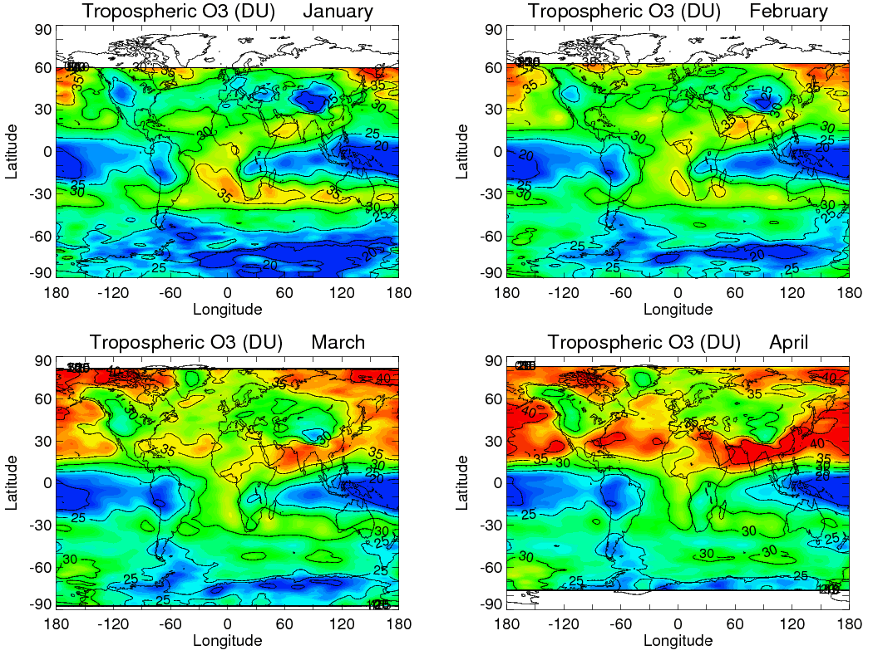

Slide 5
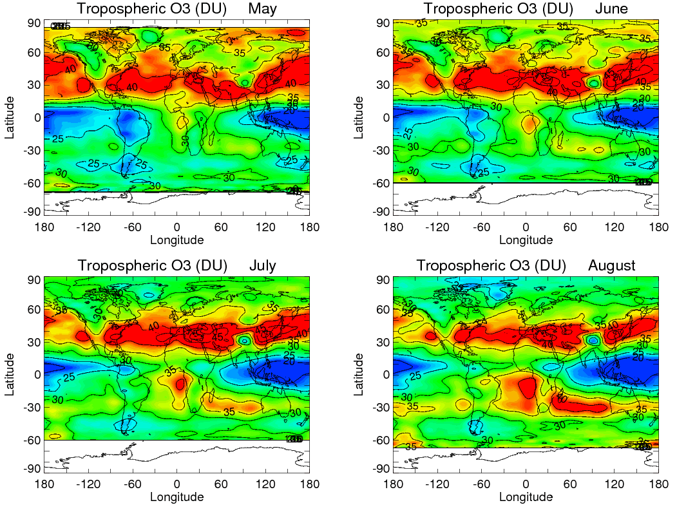

Slide 6
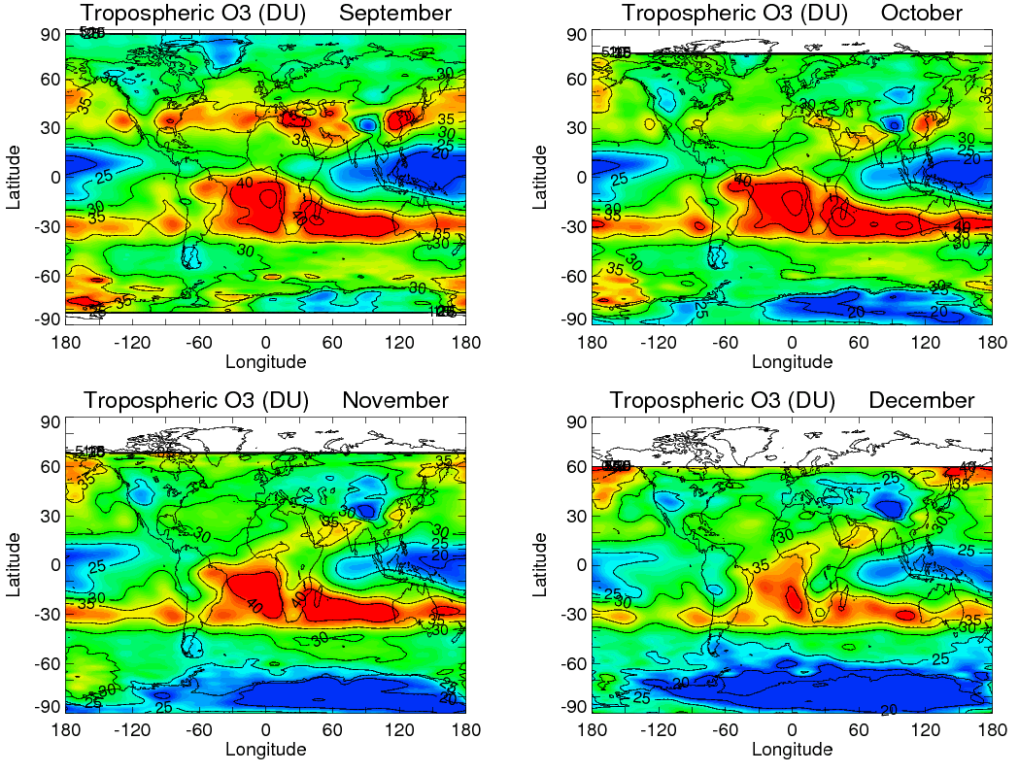

Slide 7
Global Stratospheric Column Ozone Climatology in Dobson Units
Derived from Aura MLS v3.3 ozone profile measurements from October 2004 through January 2011
Uses WMO/NCEP 2K per km lapse rate tropopause pressure definition to derive stratospheric column ozone
Missing MLS data within a few degrees of latitude from the poles are filled in using extrapolated MLS measurements from nearby lower latitudes

Slide 8
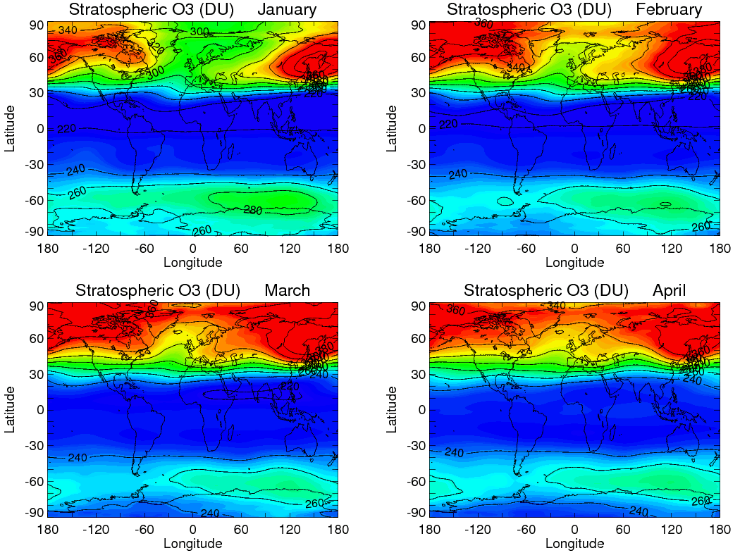

Slide 9
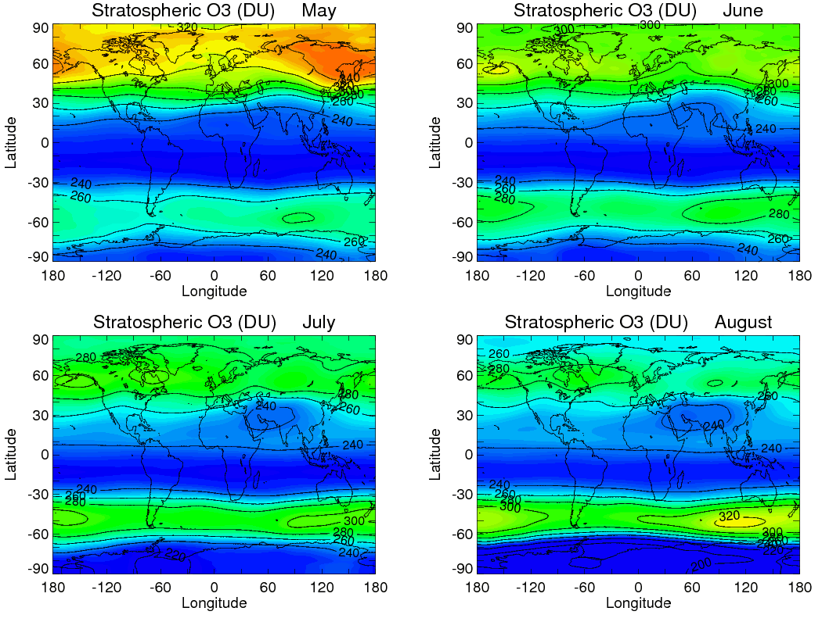

Slide 10
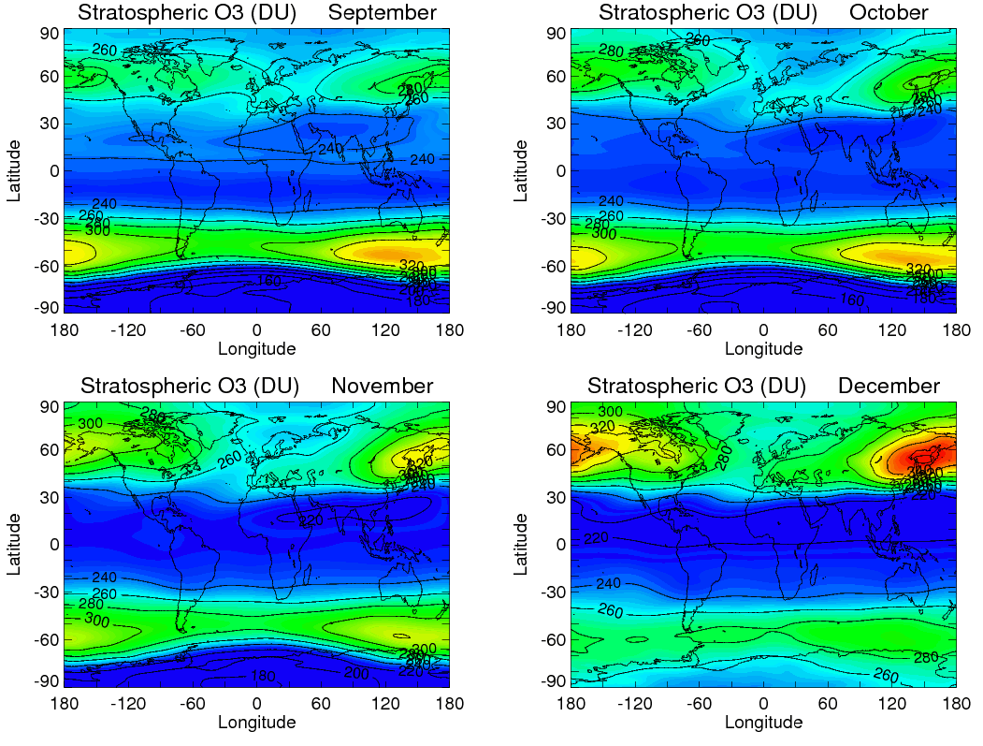

Slide 11
Global Total Column Ozone Climatology in Dobson Units
Derived from Aura OMI v8.5 measurements everywhere except in polar night latitudes
For polar night latitudes, MLS v3.3 stratospheric column ozone is about 90-95% of total column ozone – the tropospheric column ozone product is extrapolated from lower latitudes and then added to MLS stratospheric column ozone to give a close estimate of total column ozone in polar night latitudes (result: total column ozone is an entire global map for each month, just like MLS stratospheric column ozone)

Slide 12
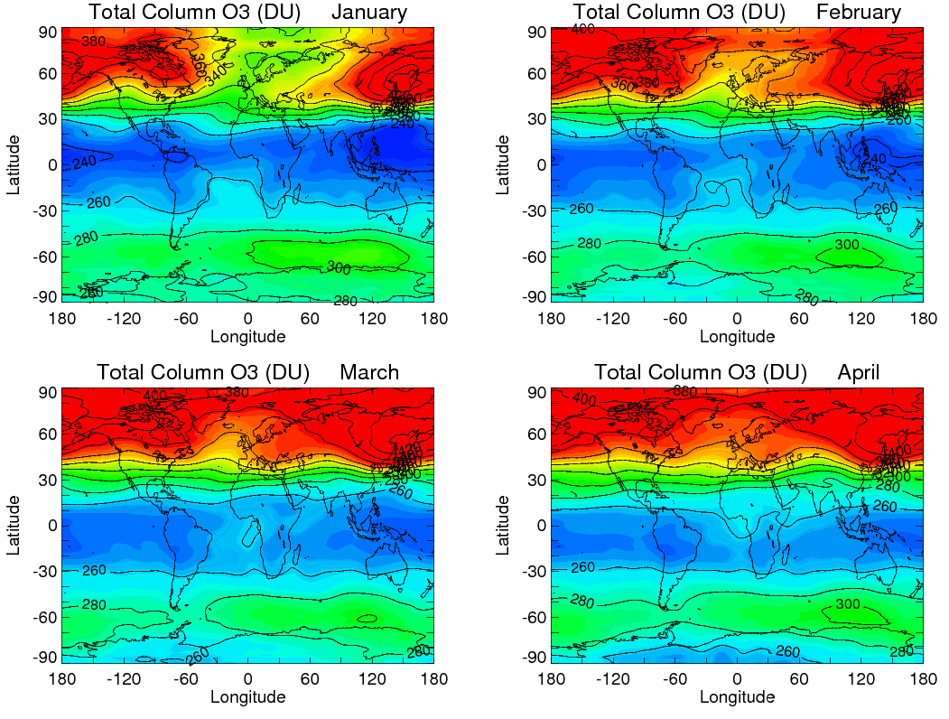

Slide 13
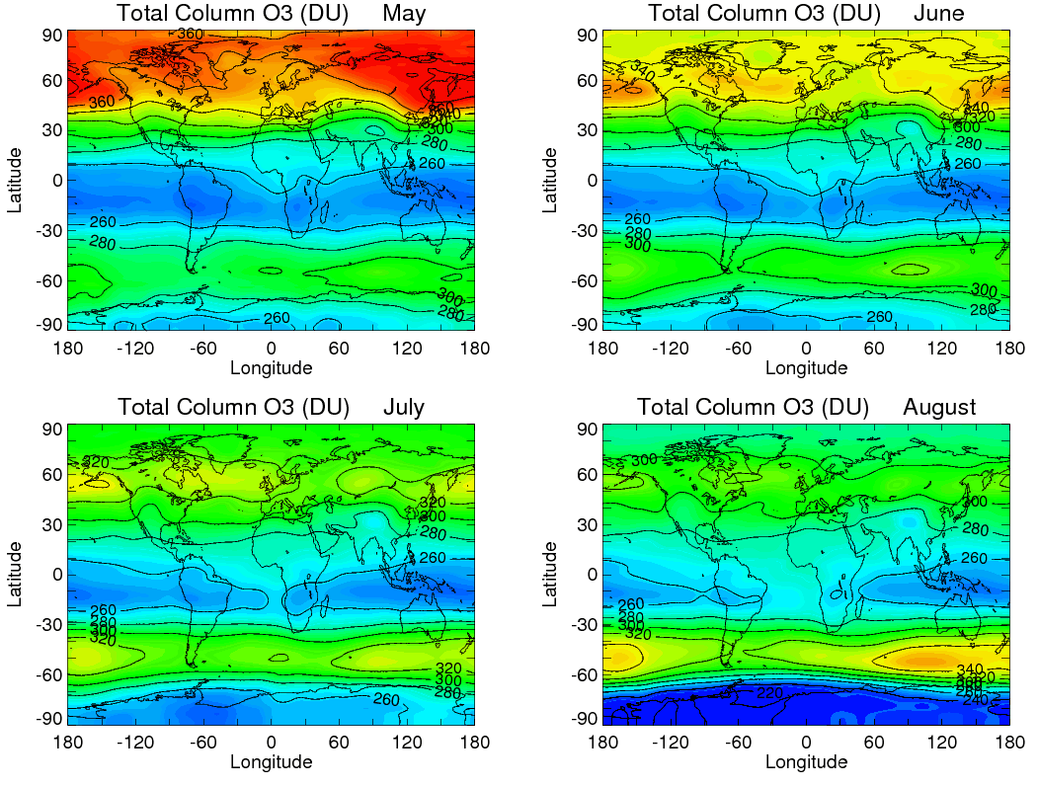

Slide 14
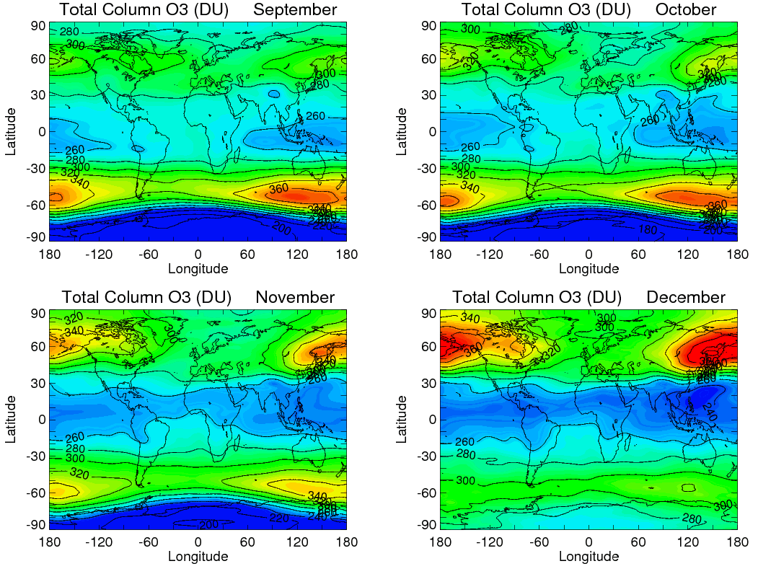

Slide 15
Global UV Index Climatology
Derived directly from the total column ozone climatology product
Derived using a UV-Index source code from P. Newman [e.g., Newman and McKenzie, 2011, Photochem. Photobiol. Sci.] which converts total column ozone and solar zenith angle at a fixed grid point to a single UV Index number
The UV-Index maps include adjustments for both local terrain altitude and also the time-averaged Earth-Sun distance for each of the months of the climatology

Slide 16
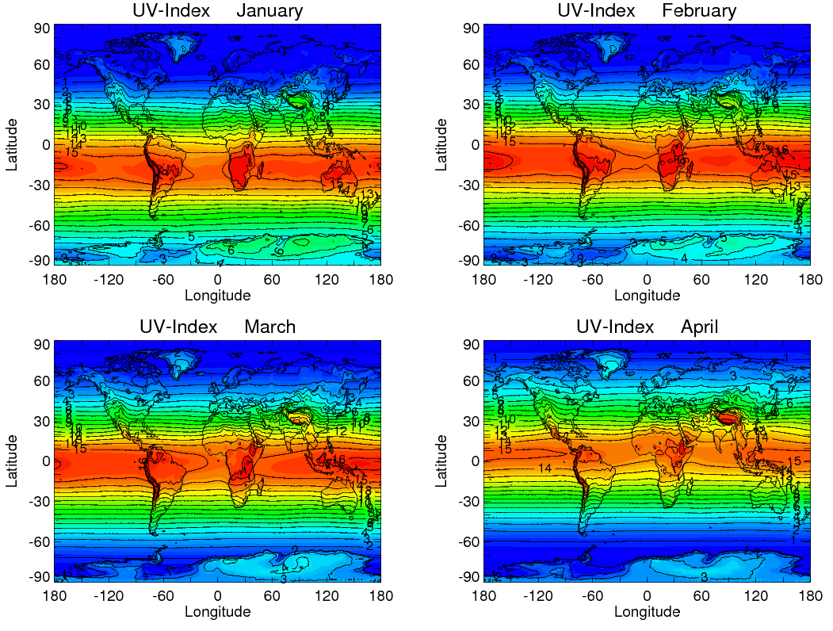

Slide 17
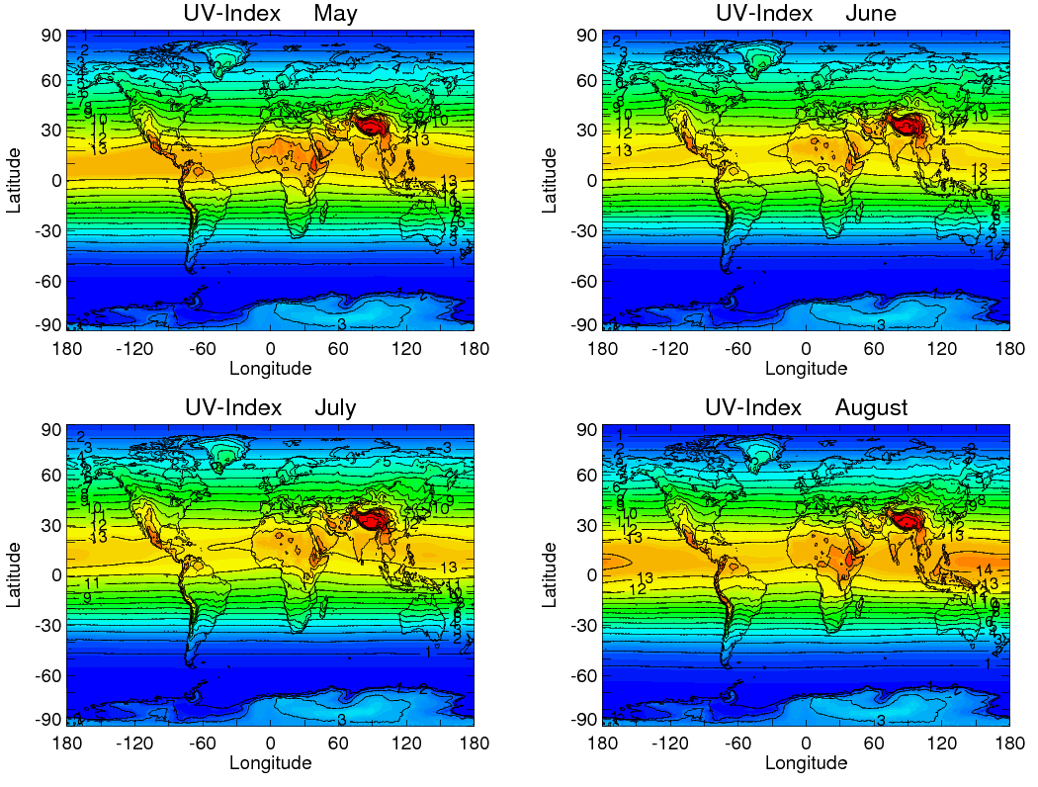

Slide 18
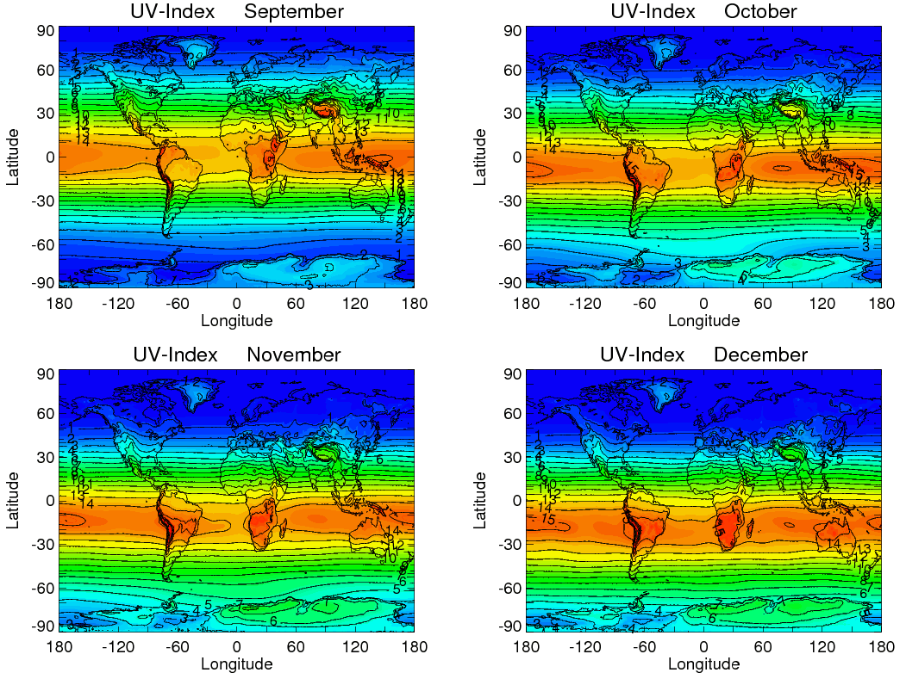

Slide 19
Extra Slides

Slide 20
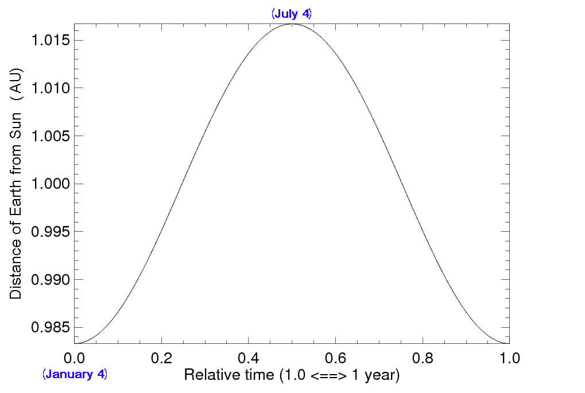
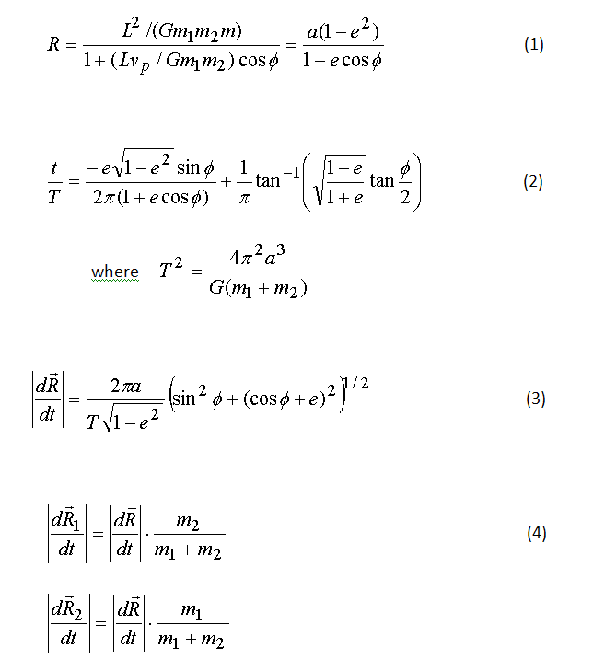
Adjustment of Surface UV
for Earth-Sun Distance
Distance of Earth from Sun as
Function of Time of Year
Exact Analytical Solution To General
Two-body Gravitational Problem
Time averaged
Earth-Sun
Month distance (A.U.)
January 0.9838
February 0.9868
March 0.9940
April 1.002
May 1.010
June 1.015
July 1.016
August 1.012
September 1.006
October 0.9967
November 0.9893
December 0.9844

