Slide 1
Team
NASA
Assaf Anyamba Jennifer Small
Richard Damoah
(GSFC)
FDA
David Oryang
Wendy Fanaselle
(FDA/ CFSAN)
Predictive Geospatial Risk Assessment Model (P-GRAM) Agricultural Contamination by E. coli
September 26-30, 2010 Raleigh, North Carolina
SRA Dec 8-11, 2013
Baltimore

Slide 2
Background – drivers
Precipitation as transport mechanism
Cooley, M. et al (2007). “Incidence and tracking of Escherichia coli O157:H7 in a major produce production region in California,” PLoS ONE, 11, e1159.

Slide 3
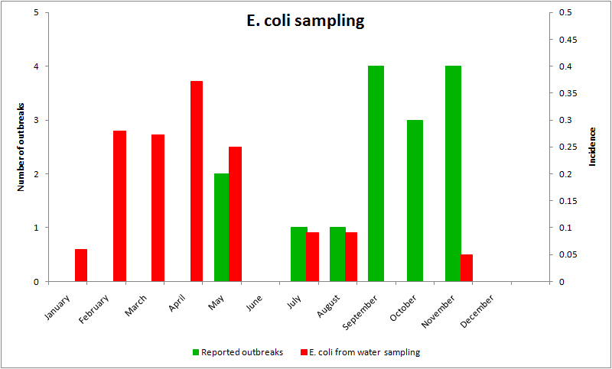
Seasonal Event Distribution
Implications for pre-harvest contamination of crops
Incidence of environmental contamination peaks in spring, during rainy season
Reported outbreaks peak in fall, after dry period
Relationship between incidence of E. coli in the environment and the occurrence of actual outbreaks is not clearly understood
We hypothesize that runoff in the spring deposits waste contaminated with E.coli near or in agricultural areas makes it possible for greens to be contaminated during the growing season

Slide 4
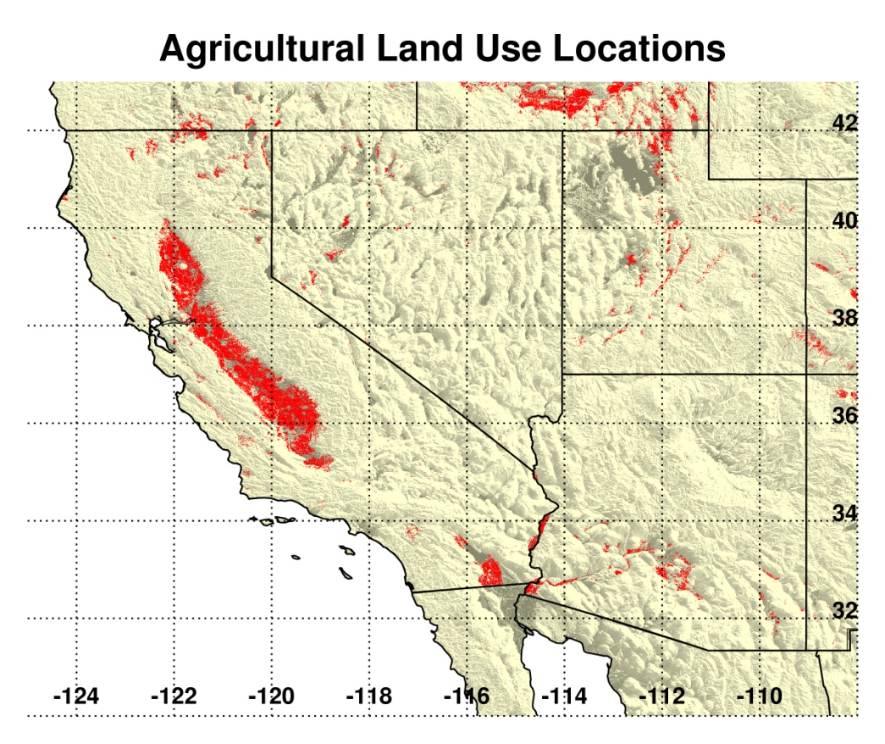
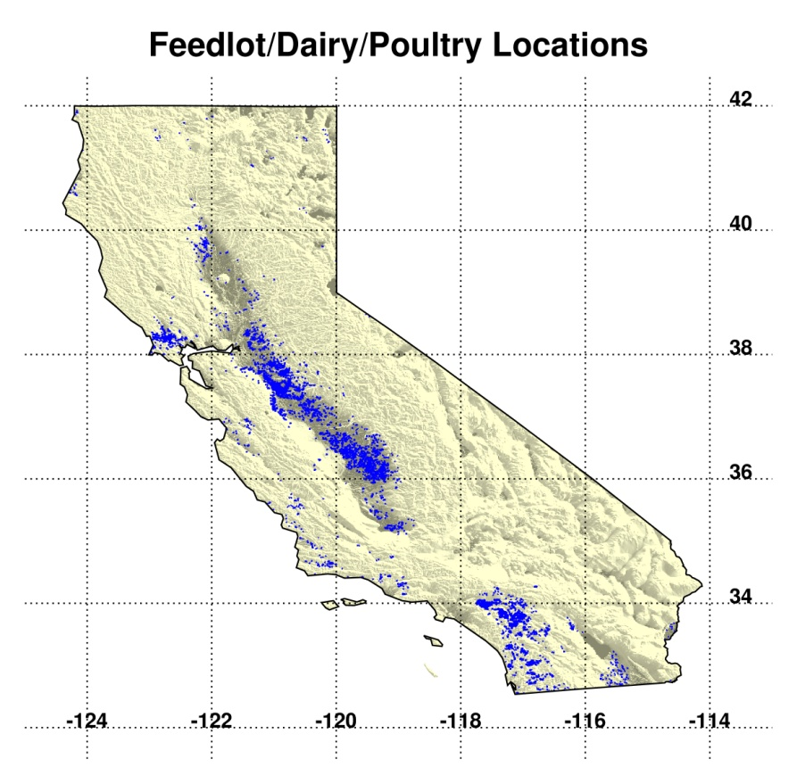
Spatial Risk Model: PGRAM
2011 NASS Cropland Data Layer (NASS Cropland Layer updated annually)
Crop mask contains all agricultural land instead of “fruits and vegetables” only
Includes feedlot, dairy and poultry locations from CA Dept of Water Resources Land Use Survey: http://www.water.ca.gov/landwateruse/lusrvymain.cfm
Cumulative precipitation and NDVI anomalies updated every 8 days
Analysis Domain includes CA, NV, AZ
From Rangel et al, 2005
Notes:
Rangel et al (from CDC) – study looked at outbreaks reported by the CDC, defined as more than two cases of E. coli
Plots show transmission routes, and vehicles for food borne outbreaks by year, as reported to the CDC by state agencies
Estimate on illnesses from CDC researcher. If estimate includes other strains of E. coli it is more than twice as large.
Estimated cost include costs of medical care, lost productivity, and premature deaths.

Slide 5
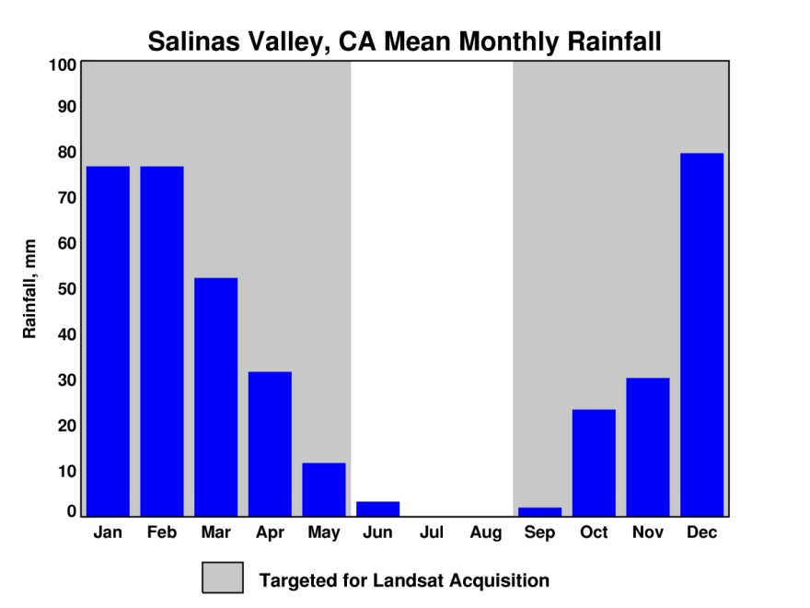
Seasonality
Growing Season: September to May: Rain-fed Agriculture
Irrigation – year round?
Risk classification is based on evaluating rainfall leading indicators (precipitation and NDVI)
Overland runoff leads to accumulation of fecal matter and other waste in zones of potential contamination
Rainfall risk category classification
32 day cumulative total at least 21.3 mm
High risk if anomaly at least 30%
Moderate risk if anomaly at least 15%
Low risk if anomaly at least 5%
NDVI risk category classification
32 day cumulative total at least 0.2
High risk if anomaly at least 20%
Moderate risk if anomaly at least 10%
Low risk if anomaly at least 5%
Overall risk is the maximum of the rainfall and NDVI risk classifications
Notes:
Once deposited in the environment, survival of E. coli depends on a variety of factors that are highly interrelated in complex ways – effects of many factors are non-linear and increase/decrease die-off only under high or low extremes
It is generally difficult to account for all factors in experimental settings, which has lead to some contradictory results in existing studies

Slide 6
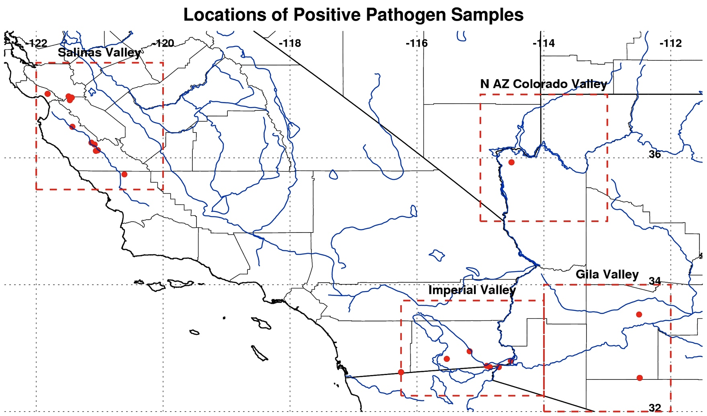
Overview Map
Overview map goes here

Slide 7
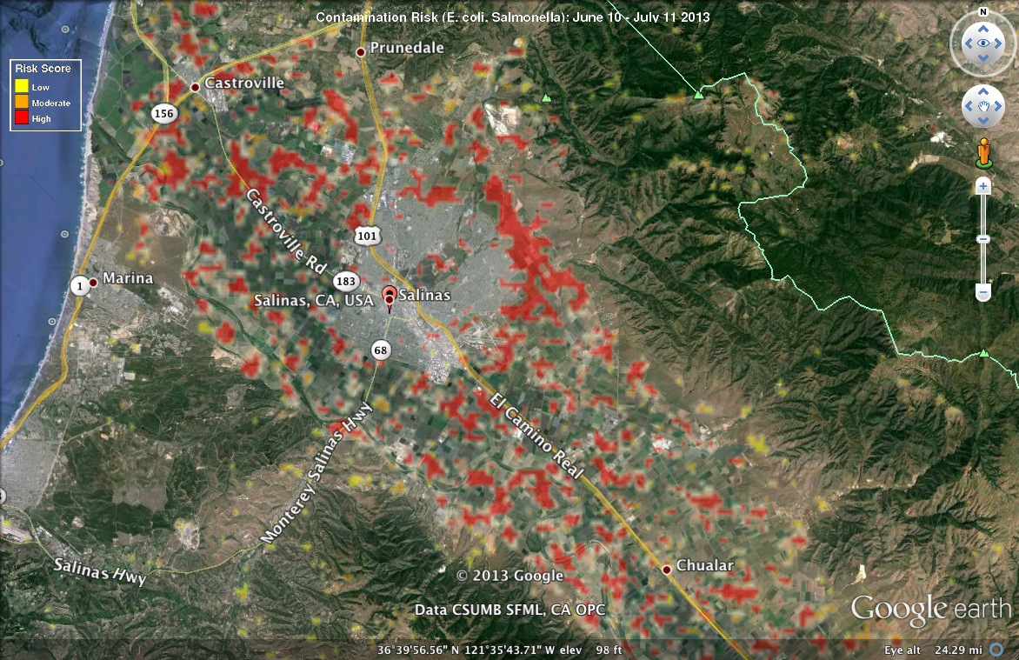
Salinas Valley: June 10 - July 11, 2013

Slide 8
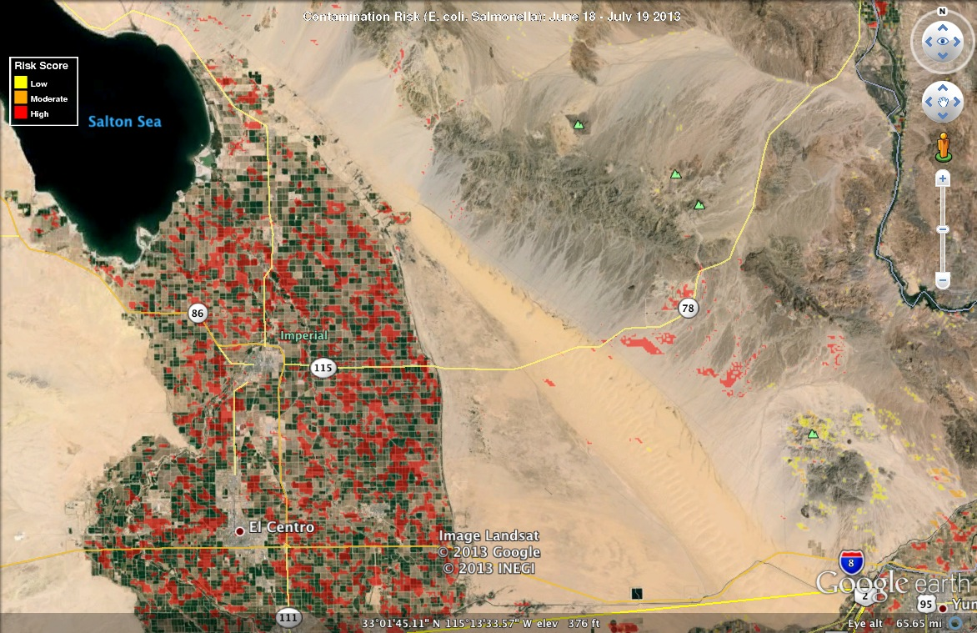
Imperial Valley: June 18 – July 19, 2013

Slide 9
ARS/FDA Environmental Sampling 2011/2012 for Validation
“Salad bowl of America”
Since 1996, at least 11 outbreaks of E. coli have been traced to the Salinas Valley
Month-Year | Location of outbreak | No. of Ill | Known or suspected vehicle
May-96 | IL, CT | 61 | Lettuce, Mesclun mix
Sep-99 | CA | 8 | Lettuce, Romaine
Sep-99 | WA | 6 | Lettuce, Romaine
Oct-99 | OR | 3 | Lettuce, Romaine hearts
Oct-99 | PA | 41 | Lettuce, Romaine
Jul-02 | WA | 29 | Lettuce, Romaine
Nov-02 * San Joaquin Valley | IL,WI,MN,SD,UT | 24 | Lettuce
Sep-03 | CA | 57 | Lettuce, Iceberg/Romaine
Oct-03 | CA | 16 | Spinach
Nov-04 | NJ | 6 | Lettuce
Sep-05 | MN | 11 | Romaine,also vegetables
Aug/Sep-06 | 26 states | >200 | Spinach, baby, bagged
May-08 | WA | 10
Source: Mandrell, R. E. 2009. Enteric human pathogens associated with fresh produce: sources, transport, and ecology. In Microbial Safety of Fresh Produce, ed. Xuetong Fan, Brendan A. Niemira, and Christopher J. Doona, 5-41. John Wiley and Sons, September 15.

Slide 10
ARS/FDA Environmental Sampling 2011/2012
SUMMARY: RESULTS
Pathogen | Positive Samples | # Samples | % Positive
NoroVirus-G1 | 8 | 439 | 1.82
NoroVirus-G2 | 69 | 439 | 15.72
ECO157 | 53 | 722 | 7.34
Listeria | 283 | 638 | 44.36
Salmonella | 442 | 688 | 64.24
STECs | 73 | 679 | 10.75

Slide 11
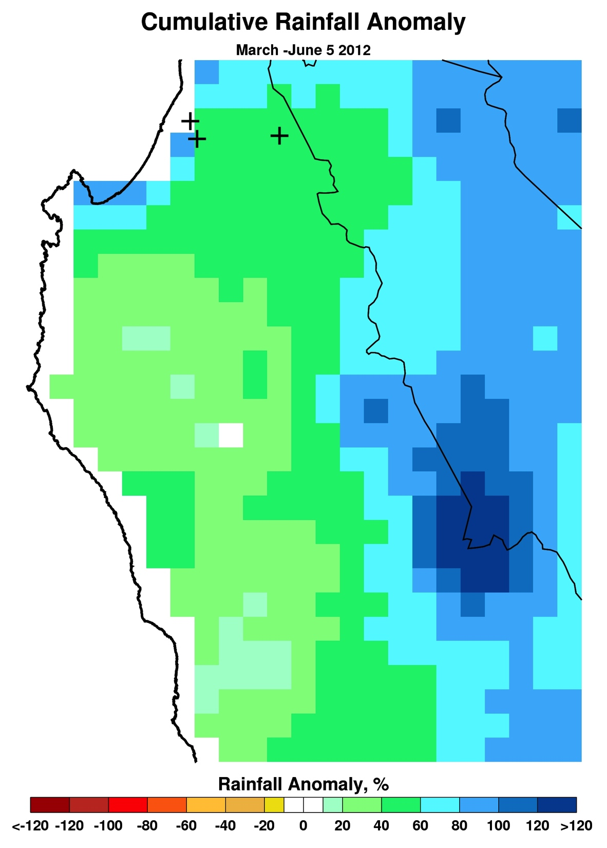
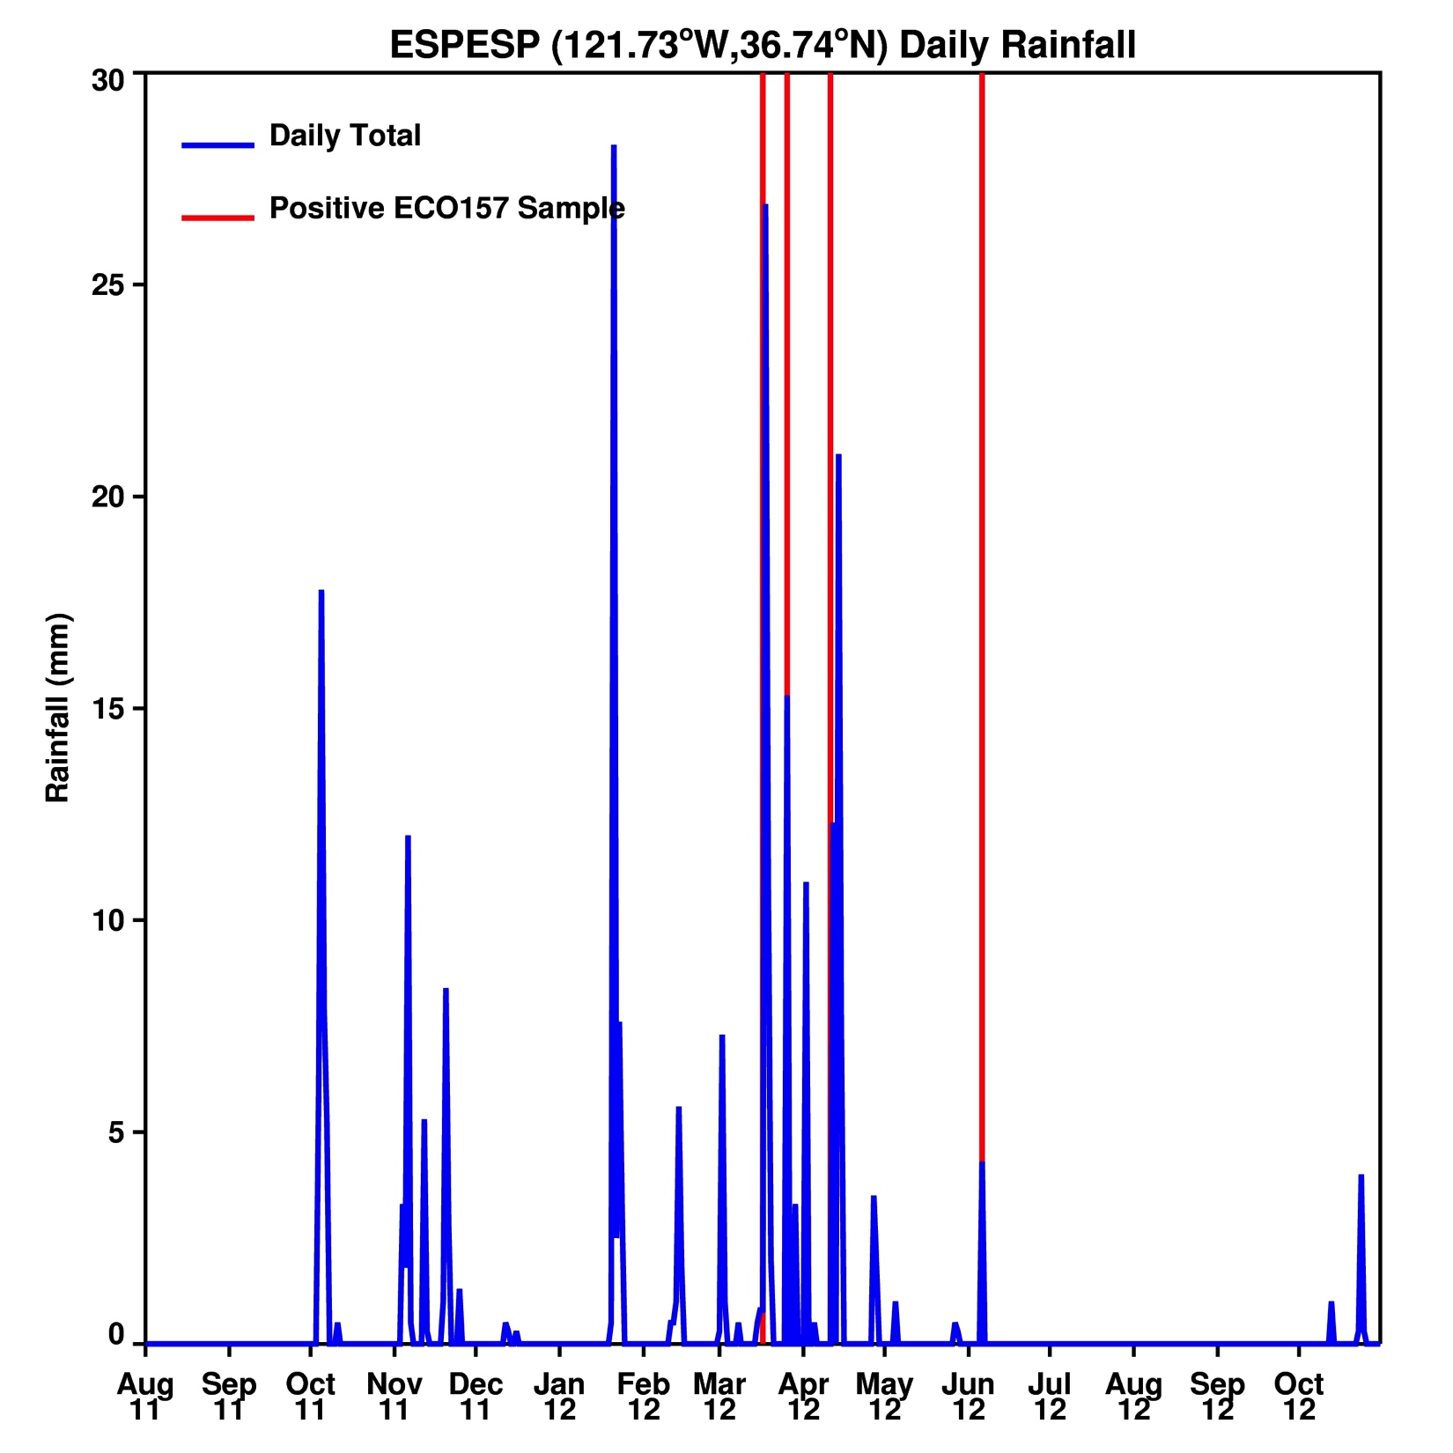
Rainfall @ ECO157 Positive Site

Slide 12
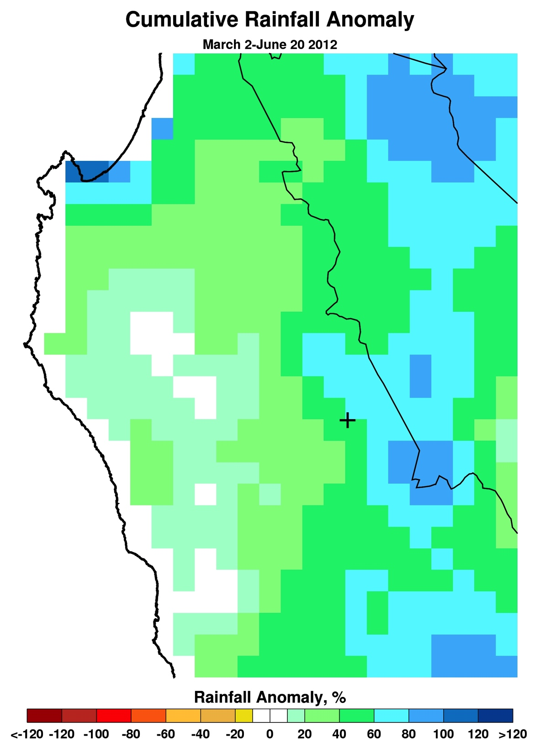
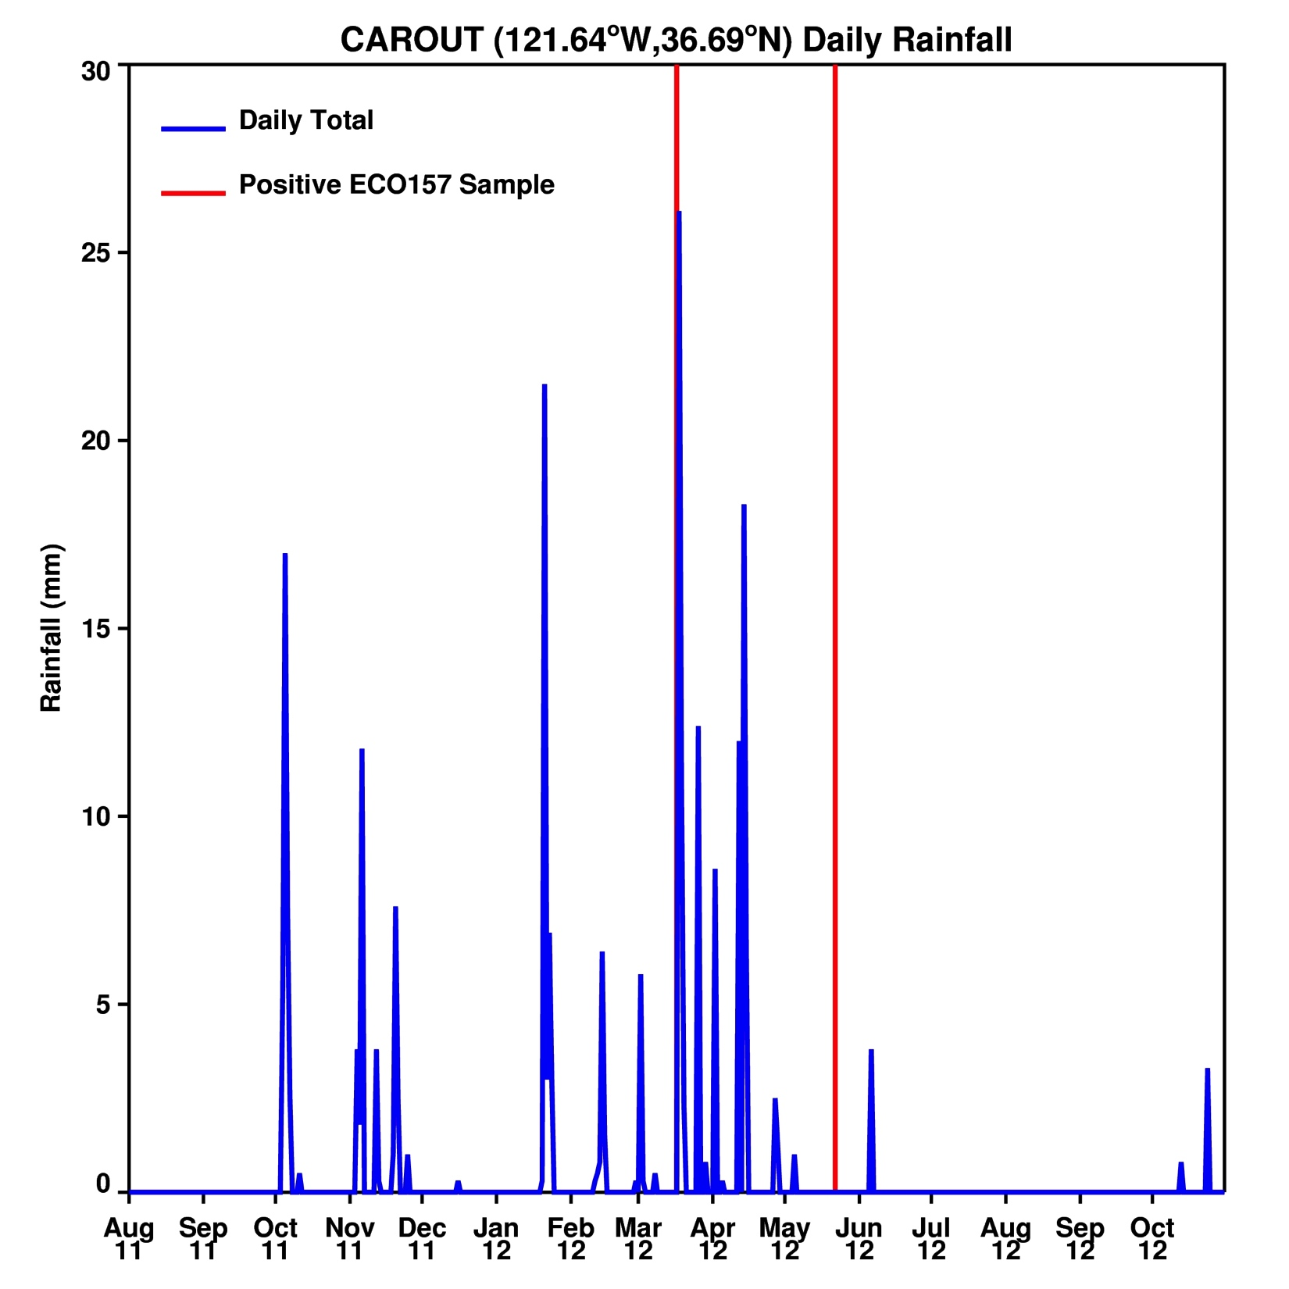
Rainfall @ ECO157 Site

Slide 13
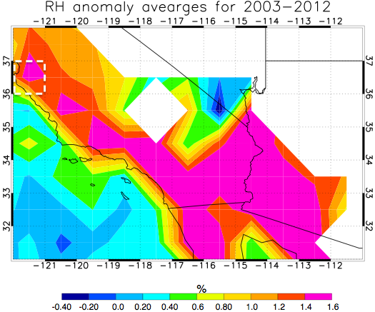
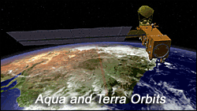
Relative Humidity Conditions
Regions with
Elevation higher than 1000 hPa are
shown with no data
Instrument
(AIRS) Atmospheric Infrared Sounder aboard Aqua
Launch date May 4, 2002
Orbit 705 km
Swath width 1650 km
Ground coverage >95% global daily
Gridded products (Level 3)
1º x 1º — daily, 8-day and monthly.
• Temperature profiles (24 levels, to 1 mb)
• Moisture profiles (12 layers, to 100 mb)
• Outgoing long-wave radiation
• Surface temperatures

Slide 14
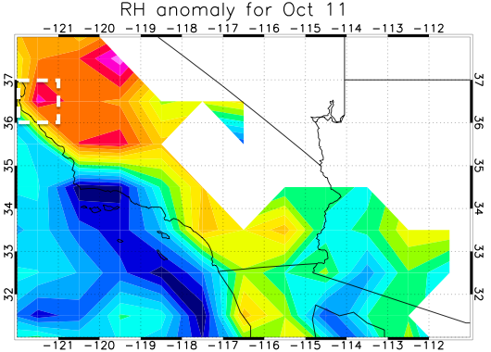
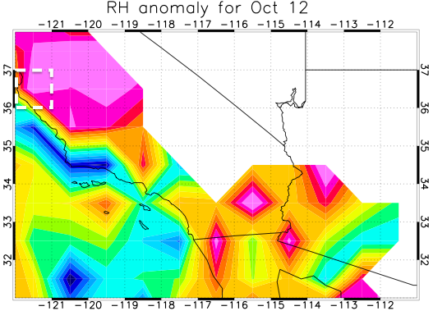
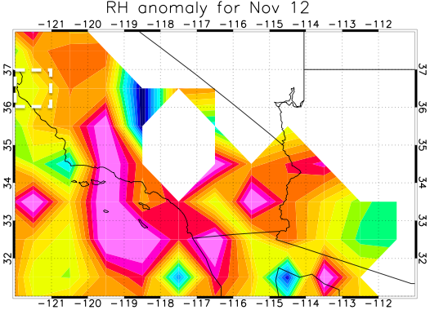
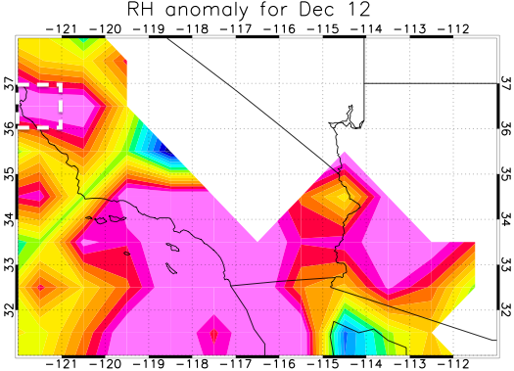
Salinas Valley: Relative Humidity Anomalies

Slide 15
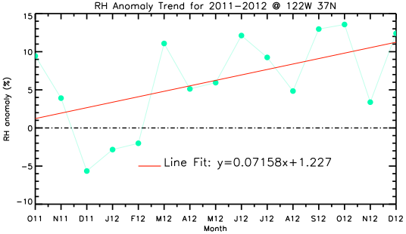
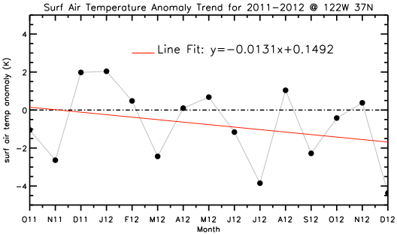
RH and Temperature Trends

Slide 16
Summary: RH and T
DATE | RH ANOMALY (%) | TEMP. ANOMALY (K)
Oct. 2011 | 9.4 | -1.06
Nov. 2011 | 3.9 | -2.65
Dec. 2011 | -5.7 | 1.99
Jan. 2012 | -2.8 | 2.05
Feb. 2012 | -2.0 | 0.48
Mar. 2012 | 11.0 | -2.45
Apr. 2012 | 5.1 | 0.11
May 2012 | 5.9 | 0.68
Jun. 2012 | 12.1 | -1.17
Jul. 2012 | 9.3 | -3.85
Aug. 2012 | 4.8 | 1.05
Sep. 2012 | 13.0 | -2.28
Oct. 2012 | 13.6 | -0.43
Nov. 2012 | 3.4 | 0.39
Dec. 2012 | 12.4 | -4.37
Green highlight shows month with no Pathogen Detection

Slide 17
SUMMARY
PGRAM Risk Maps are currently being generated in experimental mode for FDA to monitor at risk areas
Planned improvements will incorporate detailed livestock location data from ARS FLAPS project to enable improved risk characterization
Daily rainfall and Cumulative rainfall anomalies can be use as a general indicator of areas of potential pathogen risk
Generally positive pathogen detections show a positive correlation with RH anomaly. In summer pathogen detections are concentrated in the northern part of region (Salinas Valley) while in winter the detections shift to southeast (Imperial Valley). This is due to the shift of high RH anomaly from north to southeast in winter.
There is need for systematically sampled and geo-referenced produce data on ECO157/Salmonella etc.. from Industry providers for validation.

